Slide 1


暑期汇报
GPGPU并行线程调度算法
姓 名
杨伟光
时 间
2014.08.20

Slide 2

目录
1
Background
2
Round-robin policy
3
Two-level policy
4
CALSO

Slide 3
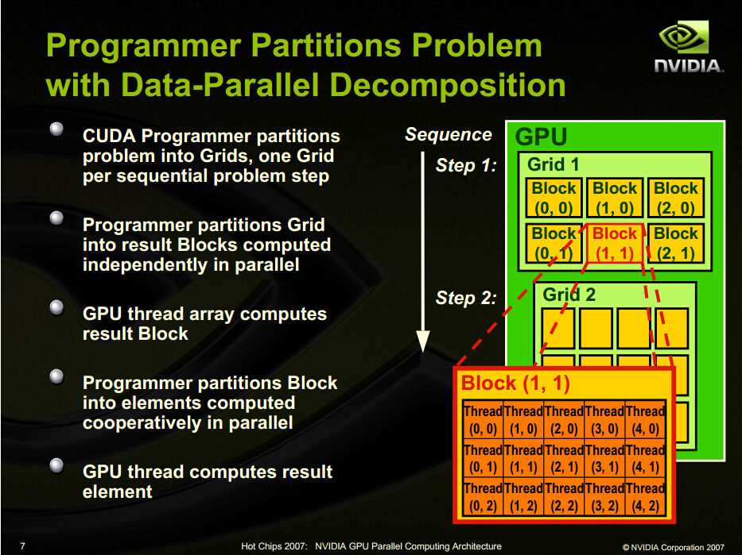
1
Introduction

Slide 4
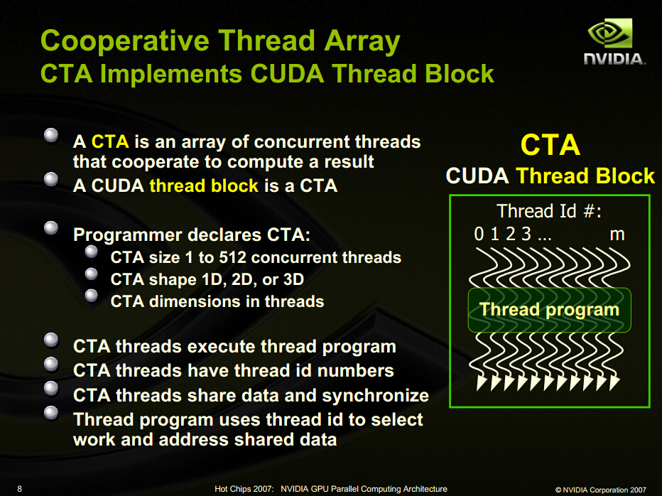

Slide 5
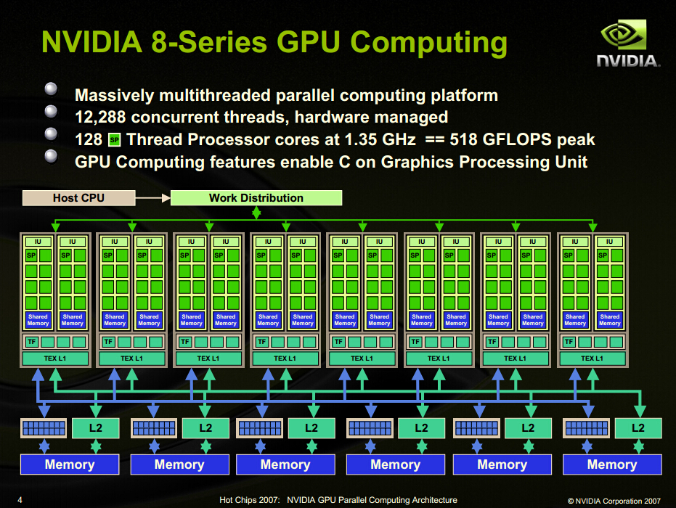

Slide 6
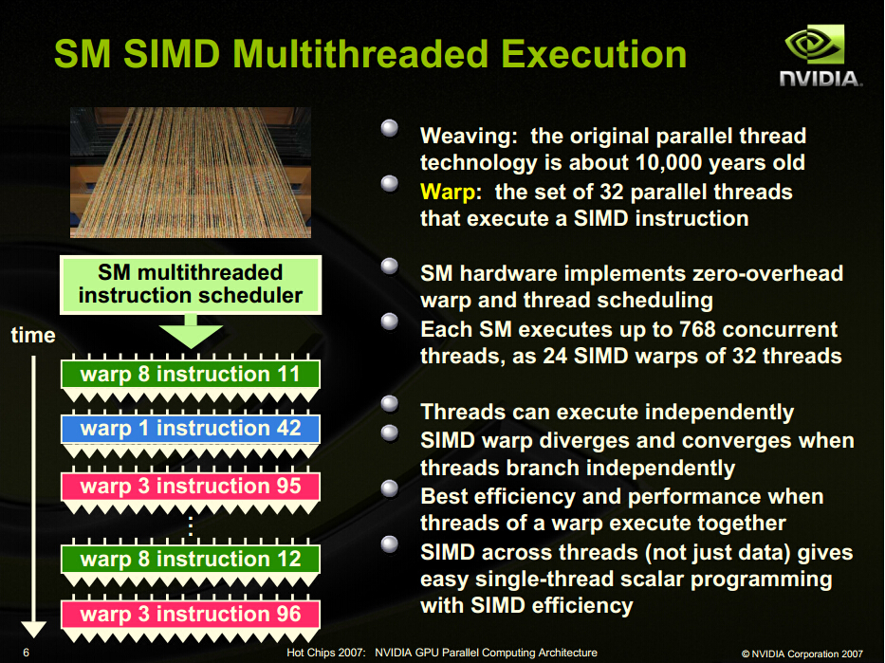

Slide 7
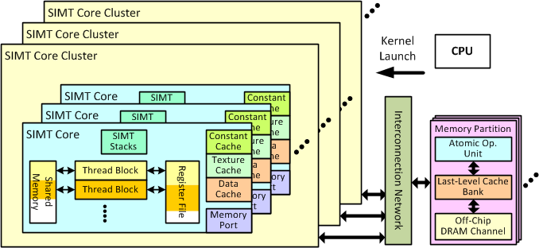
Overall GPU Architecture Modeled by GPGPU-Sim

Slide 8
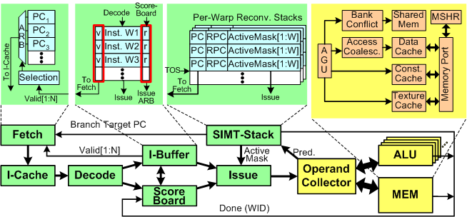
Detailed Microarchitecture Model of SIMT Core

Slide 9
2
Round-robin policy
The commonly-used round-robin (RR) policy schedules consecutive warps in consecutive cycles, assigning all warps equal commonly-used round-robin (RR) policy schedules consecu- tive warps1 in consecutive cycles, assigning all warps equal priority in scheduling.
Advantage: easy
Disadvantage:most of the warps arrive at a long-latency memory operation roughly at the same time

Slide 10
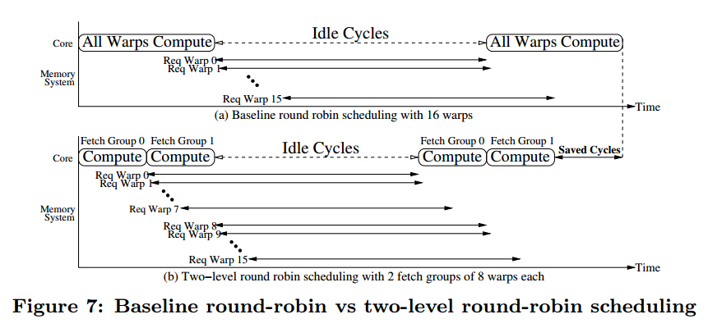
2
Two-level policy
Advantage: when warps in one fetch group are stalled on memory, warps in another fetch group can continue to execute
Disadvantage:

Slide 11
3
CLASO（motivation）
A Credit-Based Load-Balance-Aware Scheduling Optimization Scheme (CLASO)
Assumption： 4 cores , 16 CTAs
CTA Scheduler
Core 3
CTA11
CTA13
CTA7
CTA12
CTA3
CTA14
Core 2
CTA10
CTA6
CTA2
CTA5
Core 1
CTA1
CTA9
CTA8
Core 0
CTA4
CTA16
CTA0
CTA15
TotalTime
Time

Slide 12
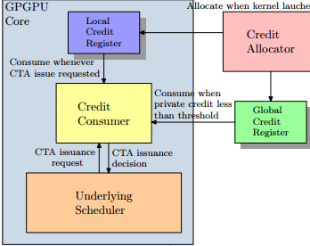
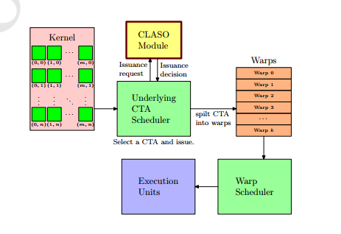

Slide 13
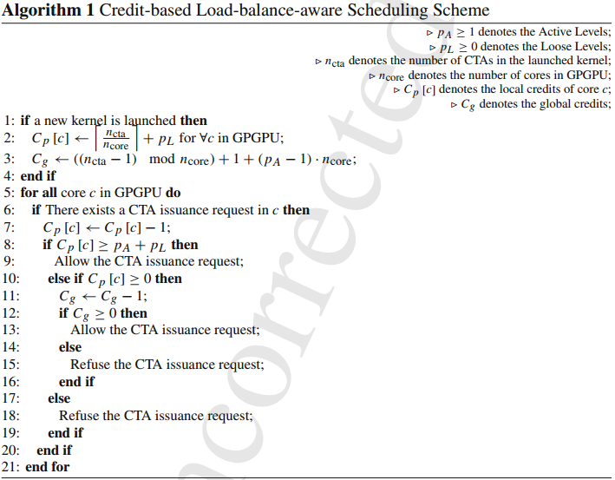

Slide 14
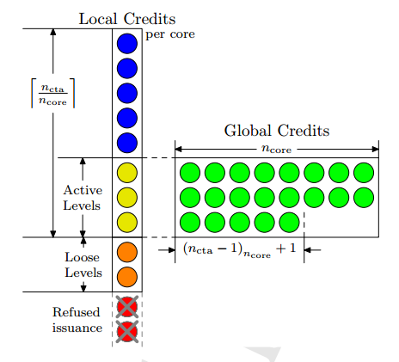

Slide 15
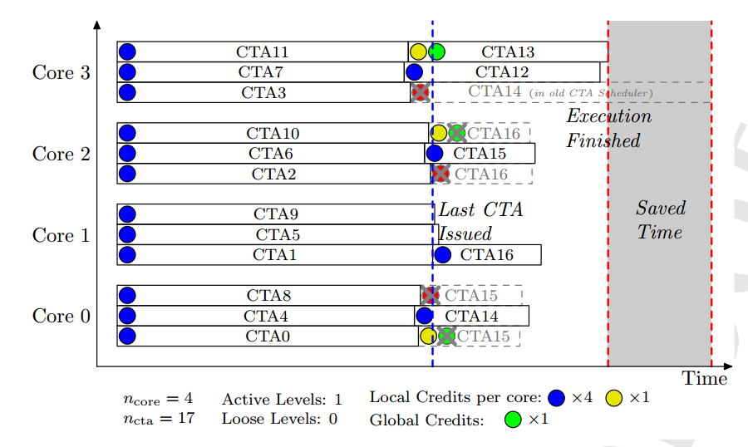

Slide 16
LOGO
Qijiayebing 作品
谢谢您的聆听

